Slide 1
The City of New Braunfels Parks and Recreation Asset Management Project

Slide 2
G.A.M.E.S.
Geospatial Asset Management Engineering Solutions
Project Manager: Kevin Scardino Assistant Manager/Web Master: Nathan Andrews GIS Technician/Data Specialist: Barkley Jenkins GIS Analyst: Mukarram Kamran

Slide 3
Introduction
Management of Government Agencies Assets
Organization and smooth operations
Waste department example
Management of Assets through the Parks and Recreation Department
Hassle for city with increasing populations
Unique attractions

Slide 4
Purpose
William Flynn (City of New Braunfels GIS Analyst and Accela Administrator) presented The GAMES with a proposal that involved
Designing an asset based schema
Implementing schema into Accela Automation
Objectives
Conducted needs assessment with city personnel
Designed 2 GIS geodatabases
Collected data with GPS unit
GAMES provided William Flynn the 2 geodatabases in order to sync with Accela

Slide 5
Scope
35 Parks 83 Properties for landscape maintenance
5 Assets for park’s system
Picnic Areas
Pavilions
Trash Cans
Spigots
Drinking Fountains
Collection of these assets focused on Landa Park.
Capable of being implemented for any other park as needed in the future

Slide 7
Literature Review
Oklahoma City, Oklahoma City Government
Improve Service to Citizens Permits and Licensing
Integrating Multiple Departments Everyone can access the same information
Reducing Inspection Turn-Around Time Reducing labor hours by preventive maintenance
Save Money $$$

Slide 8
Data
Preliminary data came from the FTP site
Missing data came from GIS extract on the City of New Braunfels website
Kelsey and Kelley provided excel tables for
Park Boundaries
Properties for Landscape Maintenance
Data Quality
Parcels needed digitizing from GIS extract
Excel tables needed to be formatted to be GIS compatible

Slide 9
Field Work
For our “test park” Landa Park
Pavilions, picnic areas, trashcans, spigots, and water fountains
Pavilions and picnic areas collected using GPS
Offsets due to tree canopy
Trash cans, spigots, and water fountains digitized
1:400 & 1:1,000 aerial maps

Slide 10
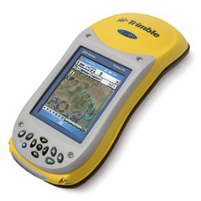
GPS & GIS
Trimble Geo XT 6000
Offsets were required for proper signal from satellites
Pathfinder Office utilized for
Data Dictionary
Import Data
Differentially Correct
Export to GIS

Slide 11
Methodology
3 Major Sections of Methodology
Park Boundary and Landscape maintenance GIS
5 Assets GIS
Synchronization of both GIS sections with Accela Automation

Slide 14
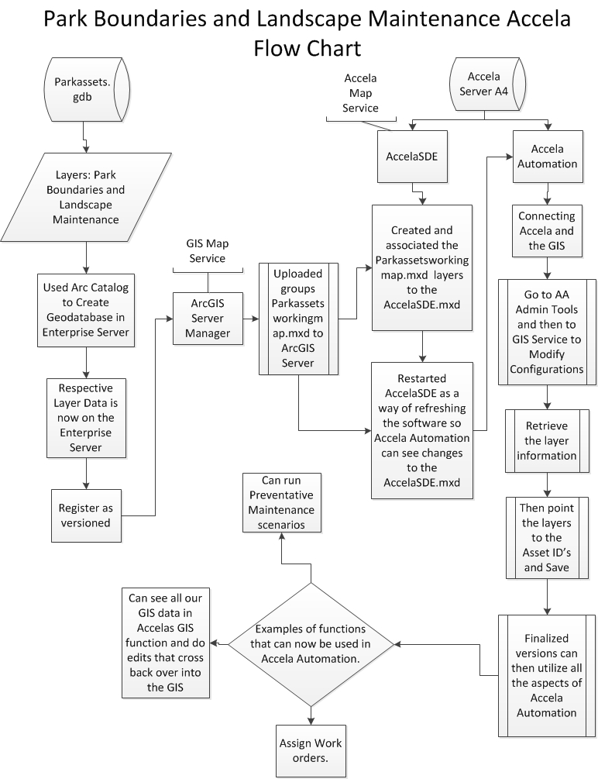

Slide 15
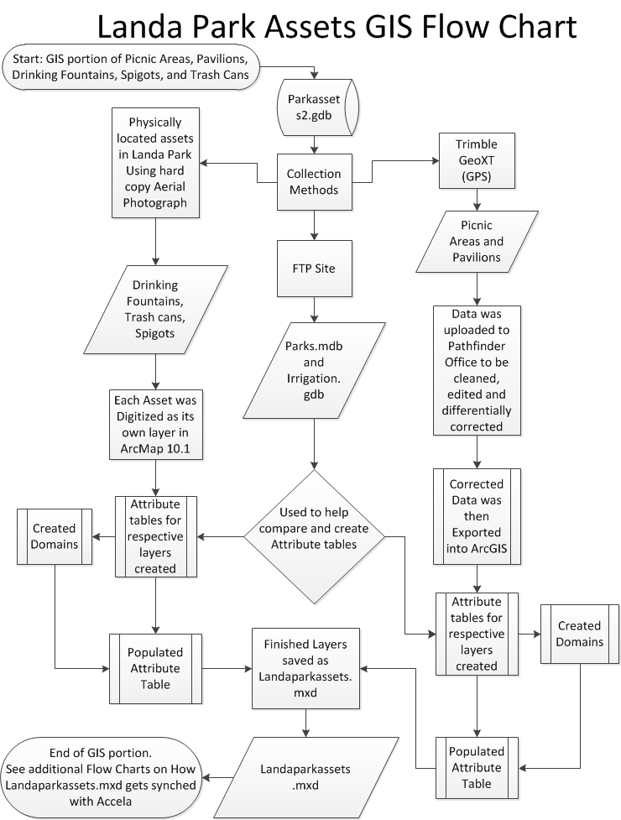

Slide 16
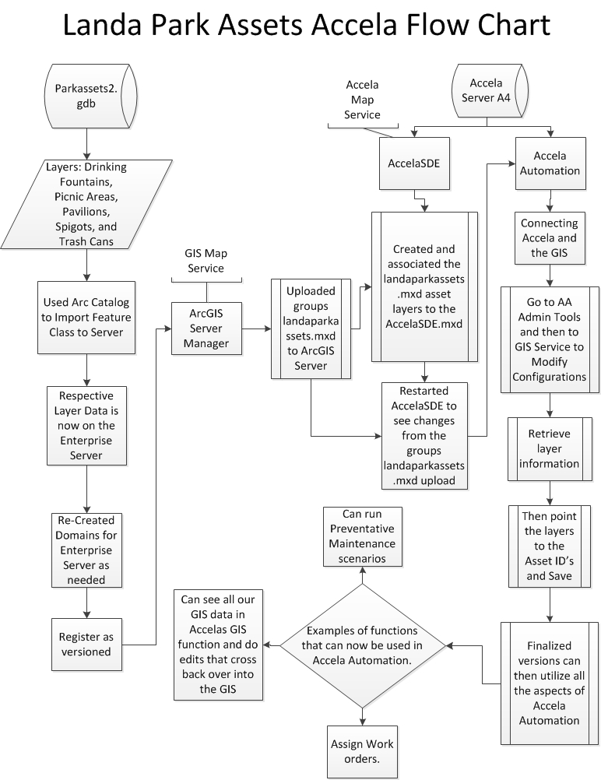

Slide 17
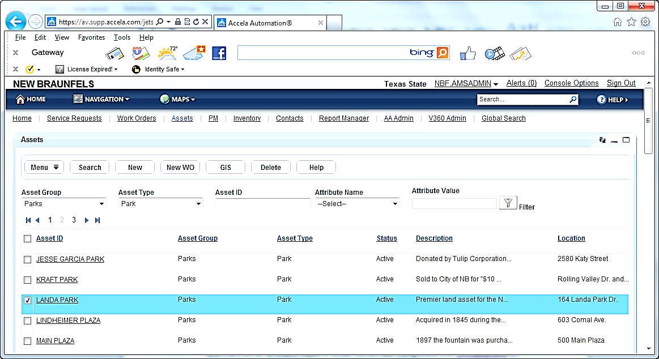
Results

Slide 18
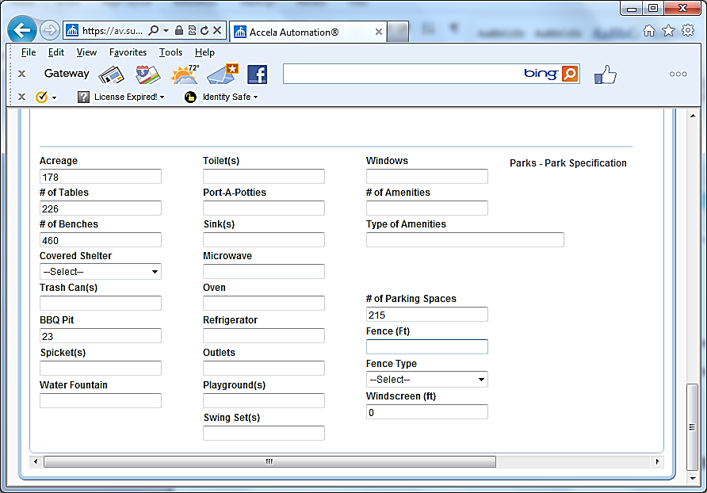

Slide 19
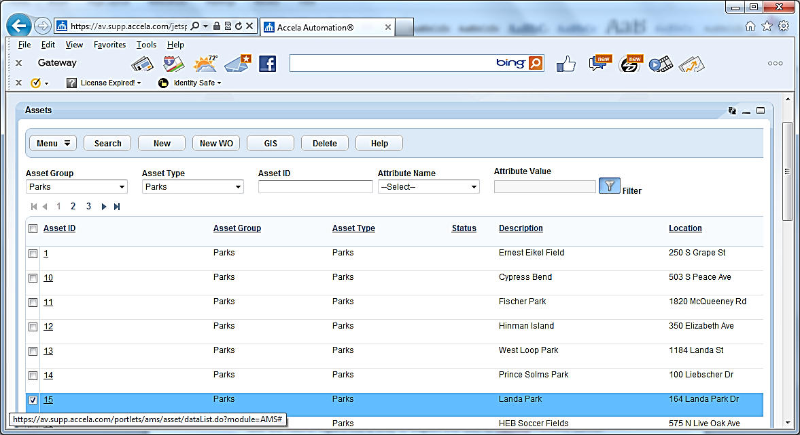

Slide 20
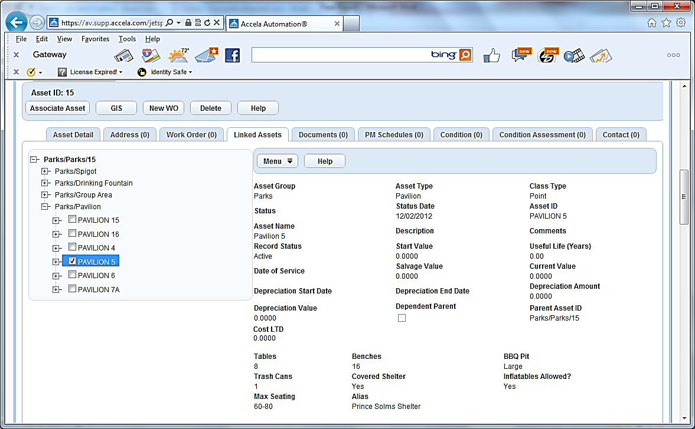

Slide 21
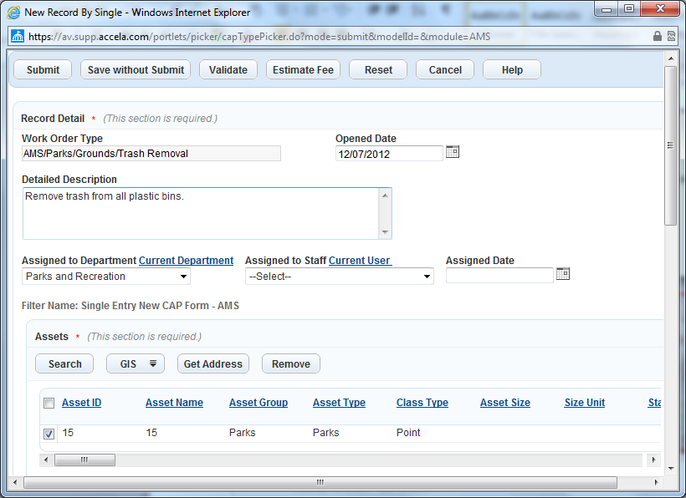

Slide 23
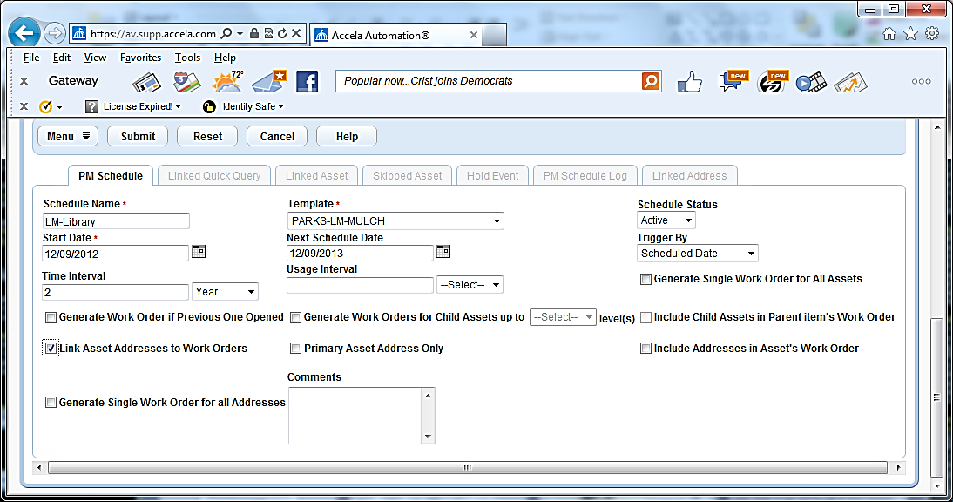

Slide 24
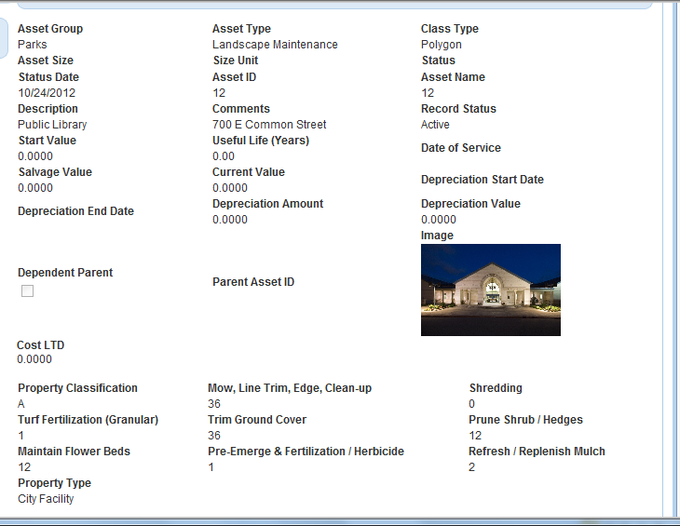

Slide 25
Discussion
ArcGIS 10.0 → ArcGIS 10.1
ArcGIS → Accela
Simultaneous Editing
No lost data
Accela → ArcGIS
Simultaneous Editing
Geodatabase file within another

Slide 26
Discussion (cont)
Implications
Parcel Data
Excel Tables
Offsets
Unique asset ID #
Work Orders
Preventive Maintenance

Slide 27
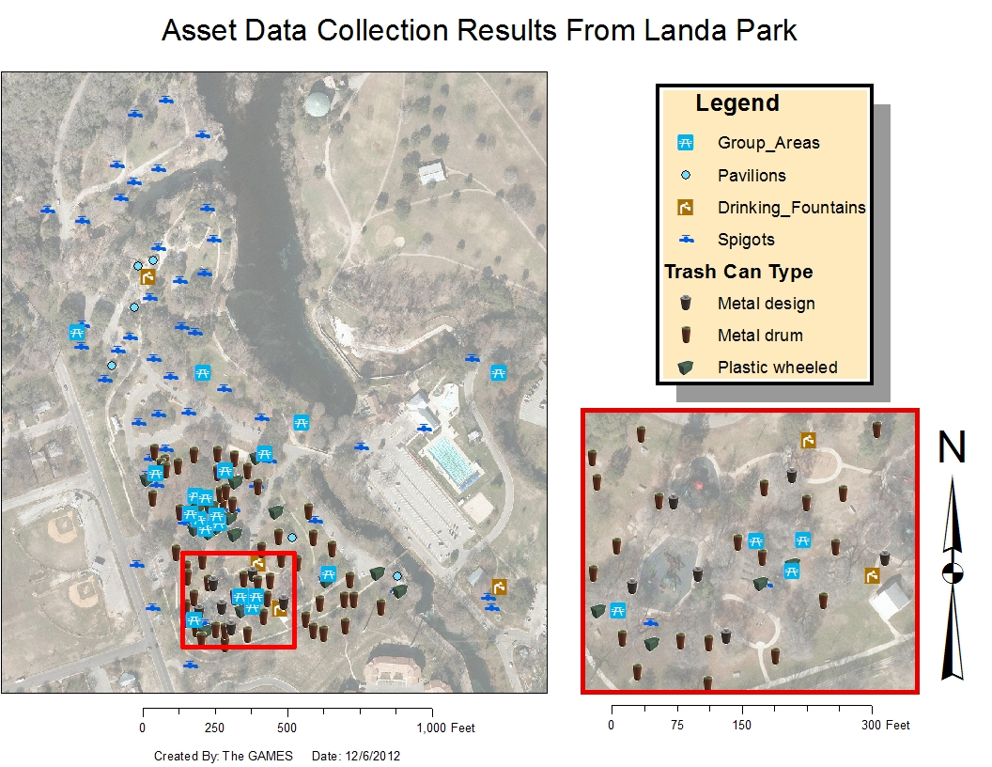

Slide 28
Conclusion
Final GIS Schema integrated with Accela
Provides tools to effectively and efficiently maintain assets
The Parks and Recreation Department’s asset information contains
Park boundaries
Landscape Maintenance Properties
Pavilions, Trash Cans, Spigots, Water Fountains, and Picnic Areas for Landa Park
Integration’s abilities
Utilize power of managing assets
Visualize asset on interactive map
Assets can be input, located, and managed on site
Provides invaluable information when needed

Slide 29
Future
Integrate Accela Automation into all of City Departments
Schema/Geodatabase can be implemented for any other park in the city.
Recommendations
Start Field Work Earlier
Find a proper browser for viewing Accela GIS

Slide 30
References
Chen, Allen. "Fort Worth Selects Accela Automation for Citywide Asset Management." Fort Worth Selects Accela Automation for Citywide Asset Management. Accela, 5 Apr. 2012. Web. 04 Dec. 2012. <http://www.accela.com/company/news/press-releases/372-fort-worth-selects-accela-automation-for-citywide-asset-management>.
"Oklahoma City." Oklahoma City. Accela, n.d. Web. 05 Dec. 2012. <http://www.accela.com/images/resources/success_stories/Oklahoma_City_OK_Licensing_Solution_SS.pdf." n.d. Accela. 12/2/2012.>.

Slide 31
Special Thanks to:
Dr. Yongmei Lu
Ryan Schurmann
William Flynn (GIS Analyst)
Kelly Eby (Urban Forester)
Kelsey Heiden (Parks and Recreation Administrative Secretary)

Slide 32
Comments or Questions?

